Slide 1
Inbox for Managers
at CMSD

Slide 2
Workday@CMSD
Workday functions have been configured for CMSD use, highlighting some functions and turning others off.
This slide deck outlines the differences between the Workday system demonstrated in the video and the functions we are using at CMSD.
The term ‘manager’ is a generic term Workday uses for anyone with direct reports. It is not a person title.

Slide 3
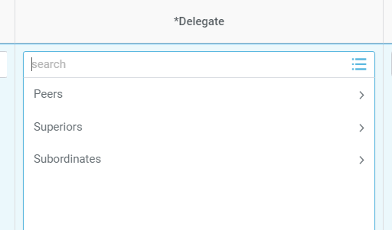
Inbox for Managers Video
When assigning a delegate for your Inbox you can:
Use the search function to find the name of person to use as a delegate.
The names of your peers, superiors and subordinates are pre-populated behind the selection arrows. You can choose the name of a delegate from that menu.

Slide 4
Inbox for Managers Video
There is an option where you can set Workday to send a notification to your Outlook inbox when you receive an action in your Workday Inbox or a Workday Notification.
You will have to log into Workday to act on the item.

Slide 5
Summary
That’s it! As summary, at CMSD:
Managers will select an Inbox delegate from lists of pre-populated peers, superiors or subordinates or they can use the search function.
Managers can setup Workday to receive notifications in their Outlook email when there is something to act on in their Workday Inbox.

Slide 6

Thank you!

